Slide 1
Lamar University College
Web Tour
College Prep
Mr. Gordon
jgordon@bisdtx.org

Slide 2
Upcoming Events
Fri. Nov. 12th 9th and 10th Texas A&M University Tour
Fri. Nov. 19th Picture Day
Sat. Dec. 4th Winter Dance All Grades are Invited
hi

Slide 3

College Web Tours
For the next several weeks, we will be researching various universities around Texas-
both public and private.
We will start with Lamar University.
hi

Slide 4


Lamar University Facts
Lamar University is located in Beaumont
3 hours 15 minutes east of Bastrop.
Lamar University is a public university.
Lamar’s mascot is the Cardinal.
hi

Slide 5
Lamar University Facts
Go to: https://www.lamar.edu/about-lu/index.html
and find the answers to the following questions.
1.How many students attend Lamar University?
2. How many degree programs does Lamar University offer?
3. What percentage are First Generation (they are the first in their family to attend college) students?
4. What degree programs are offered?
hi

Slide 6
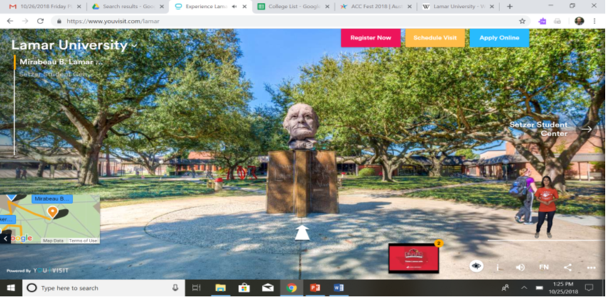
Lamar University Virtual Tour
Scroll down and take a virtual tour of the campus.
hi

Slide 7
Today’s College Prep Assignment
In the comments section of today’s College Prep,
answer the following question:
What is one thing you liked about
Lamar University?
hi

